Slide 1
ECC
M. S. Wakode

Slide 2
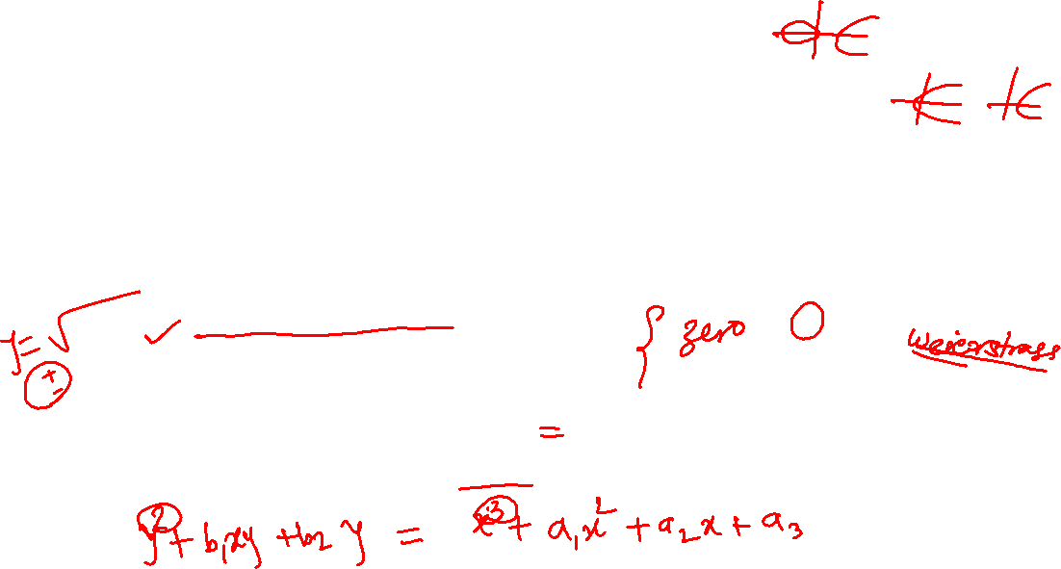
Session VII : ECDSA
Confidentiality :
Encryption/decryption algorithms- Public key cryptography:
Elliptic Curve Cryptography (ECC):
an elliptic curve is defined by an equation in two variables x & y, with coefficients
for cryptography, the variables and coefficients are restricted to elements in a finite field
elliptic curves over real numbers are described by cubic equations:
y² = x³ + ax + b
where x,y,a,b are all real numbers
also define zero point O
To plot the curve, we need to find values of y, for given value of x
The plot consists of positive and negative values of y for each value of x
Thus, the curve is symmetric about y = 0

Slide 3
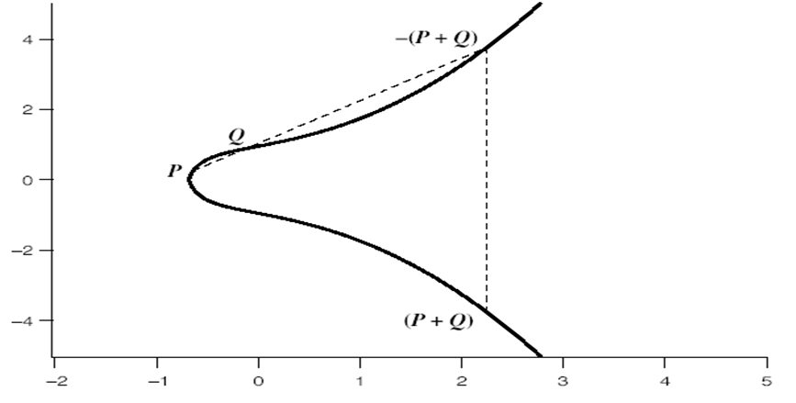
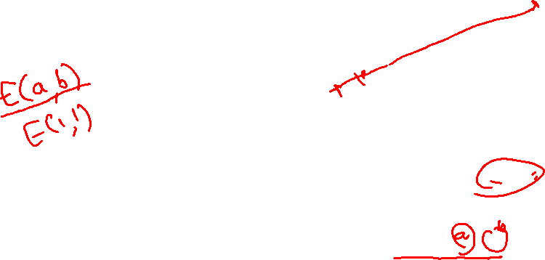
Session VII : ECDSA
Confidentiality :
Encryption/decryption algorithms- Public key cryptography:
Elliptic Curve Cryptography (ECC):
Example curve:
Fig. 5: example of elliptic curve : y² = x³ + x + 1 [1]

Slide 4
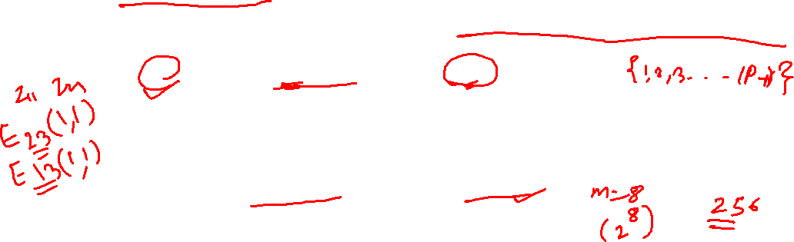
Session VII : ECDSA
Confidentiality :
Encryption/decryption algorithms- Public key cryptography:
Elliptic Curve Cryptography (ECC):
Finite Elliptic Curves
Elliptic curve cryptography uses curves whose variables and coefficients are finite integers
have two families commonly used:
1. prime curves E_{p}(a,b) defined over Z_{p}
y² mod p = (x³+ax+b) mod p
use integers modulo a prime for both variables and coefficients
2. binary curves E_{2m}(a,b) defined over GF(2^{m})
use polynomials with binary coefficients

Slide 5
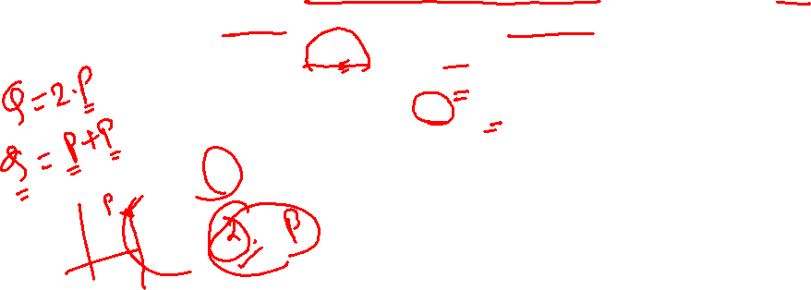
Session VII : ECDSA
Confidentiality :
Encryption/decryption algorithms- Public key cryptography:
Elliptic Curve Cryptography (ECC):
In ECC we use addition operation on finite field, it is analogue of multiplication
need “hard” problem equivalent to discrete log
Consider Q=kP, where Q,P are points in an elliptic curve
is “easy” to compute Q given k,P
but “hard” to find k given Q,P
known as the elliptic curve logarithm problem
k must be large enough so as to make brute-force fail

Slide 6
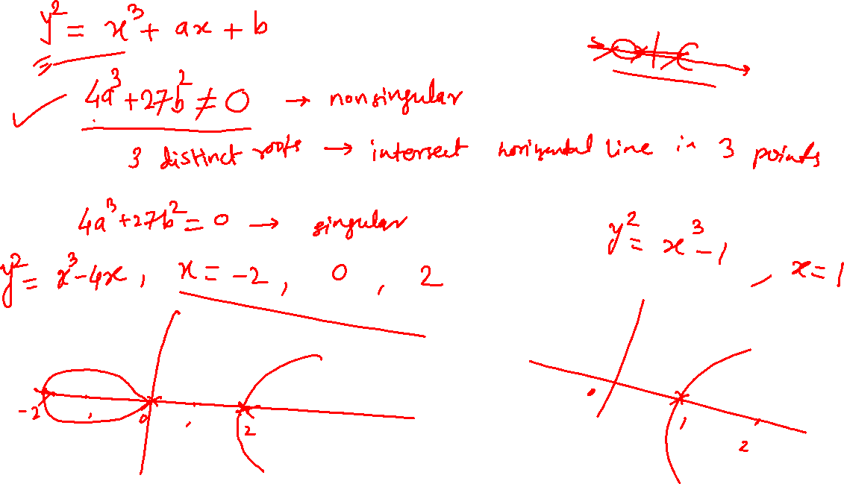

Slide 7
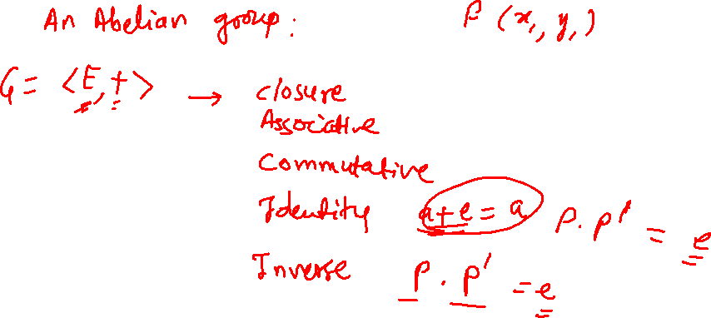

Slide 8
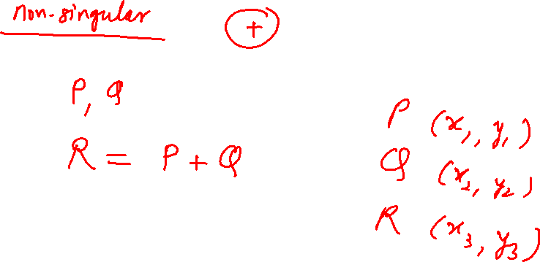

Slide 9
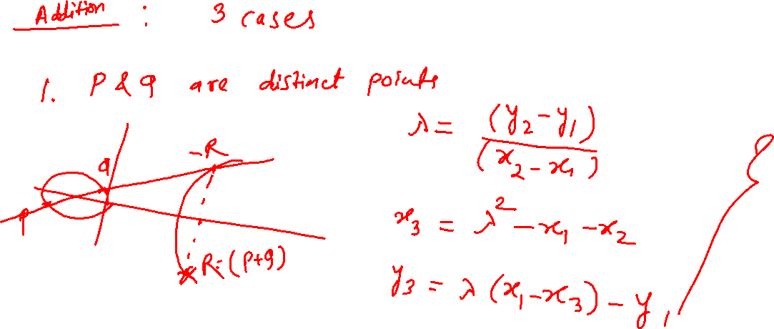

Slide 10
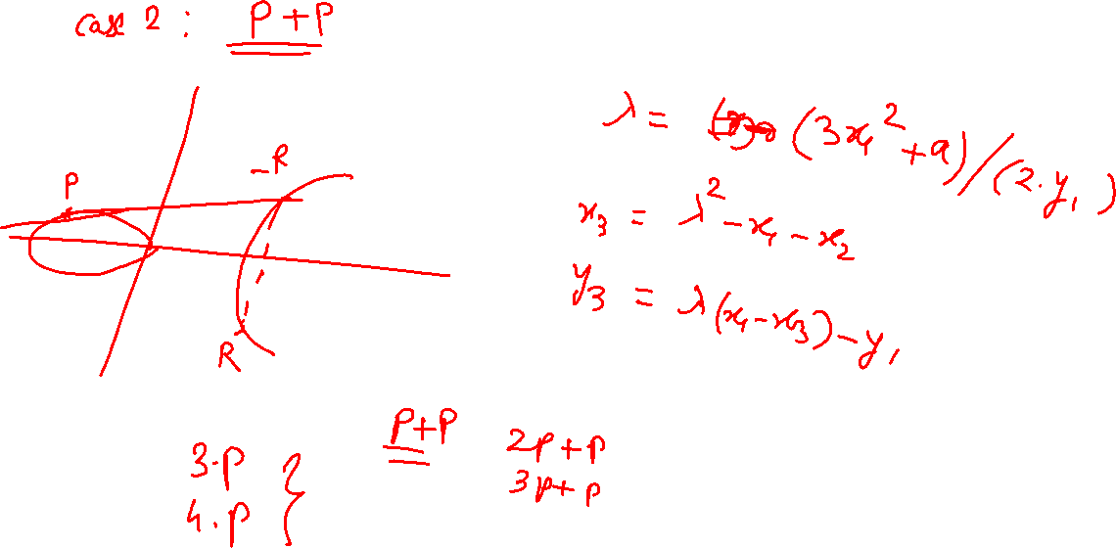

Slide 11
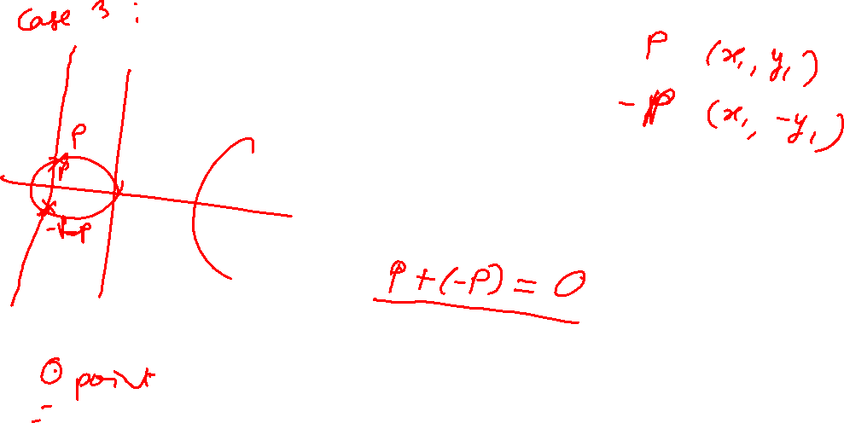

Slide 12
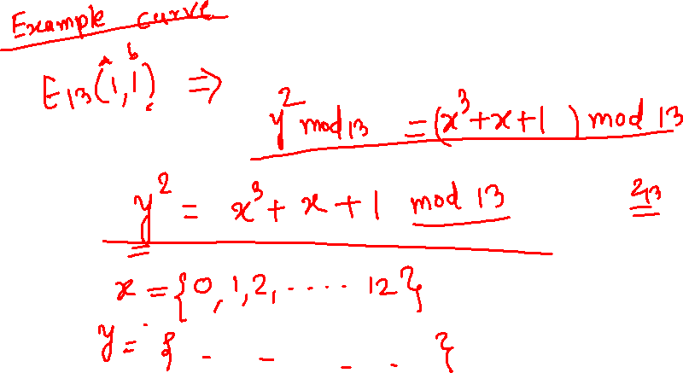

Slide 13
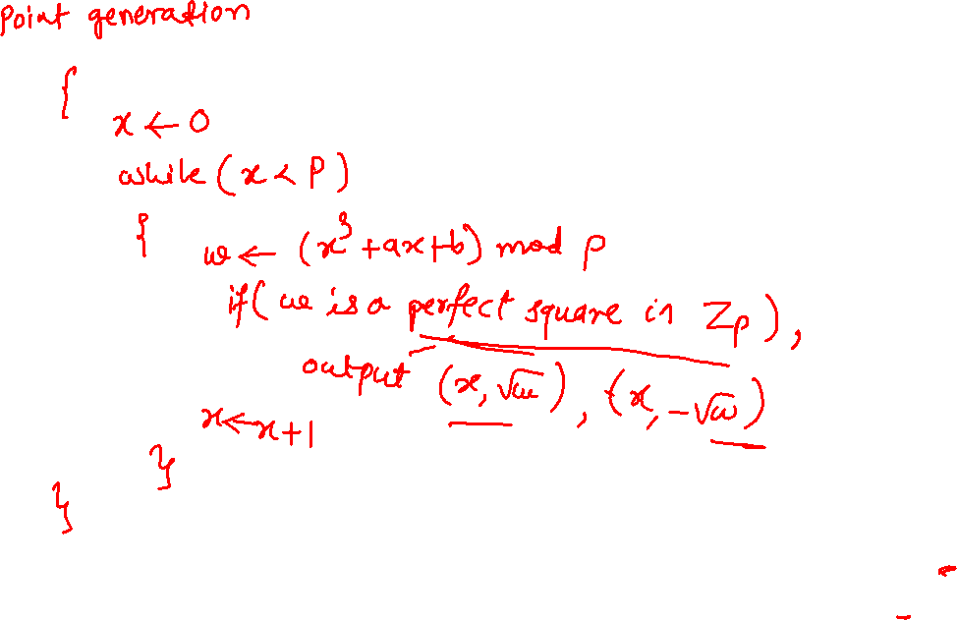

Slide 14
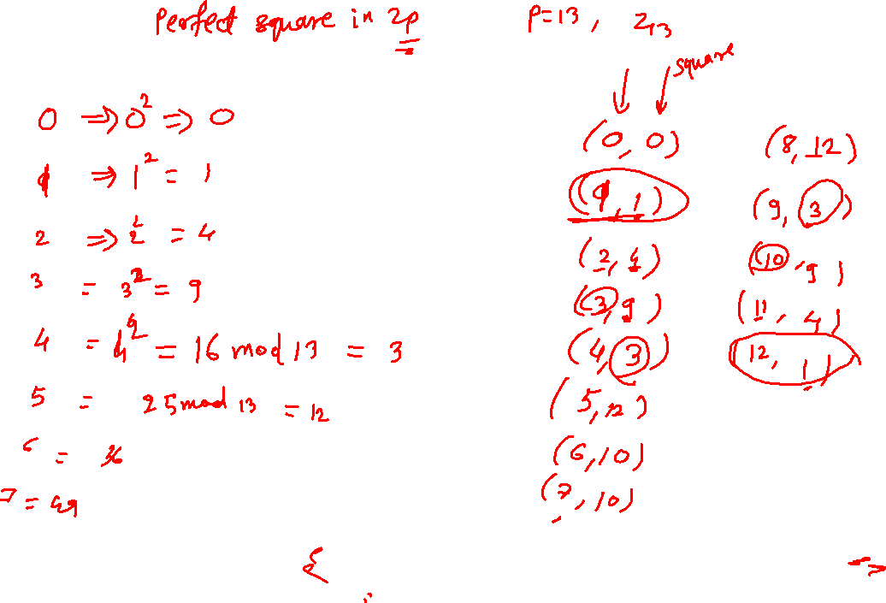

Slide 15
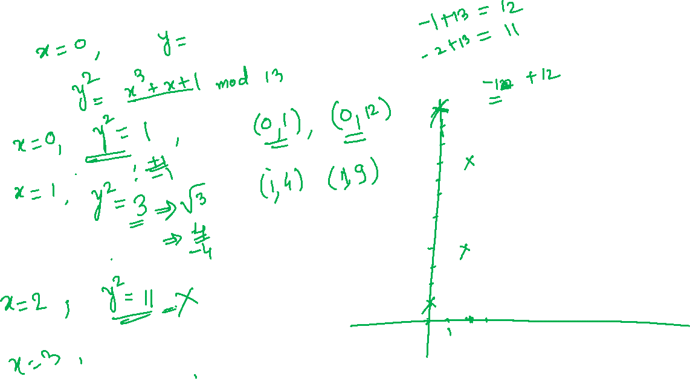

Slide 16
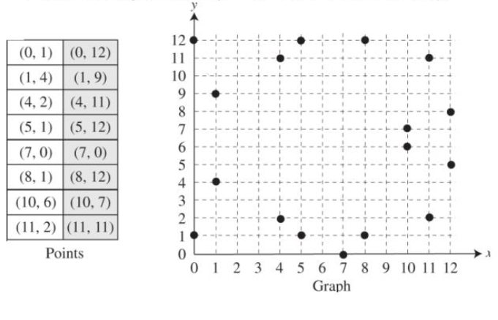


Session VII : ECDSA
ECC
Points on the curve:
E₁₃(1,1)
Fig. 6: example of elliptic curve : y² = x³ + x + 1 mod 13 [2]

Slide 17
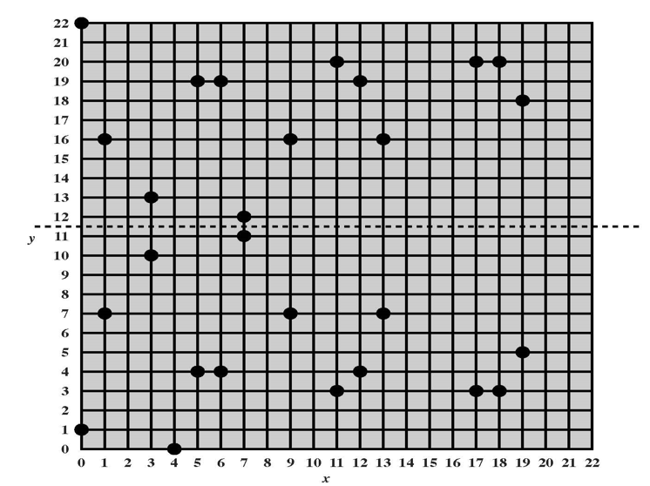
Session VII : ECDSA
ECC
Points on the curve:
E₂₃(1,1)
Fig. 7: Example of elliptic curve : y² = x³ + x + 1 mod 23 [1]

Slide 18
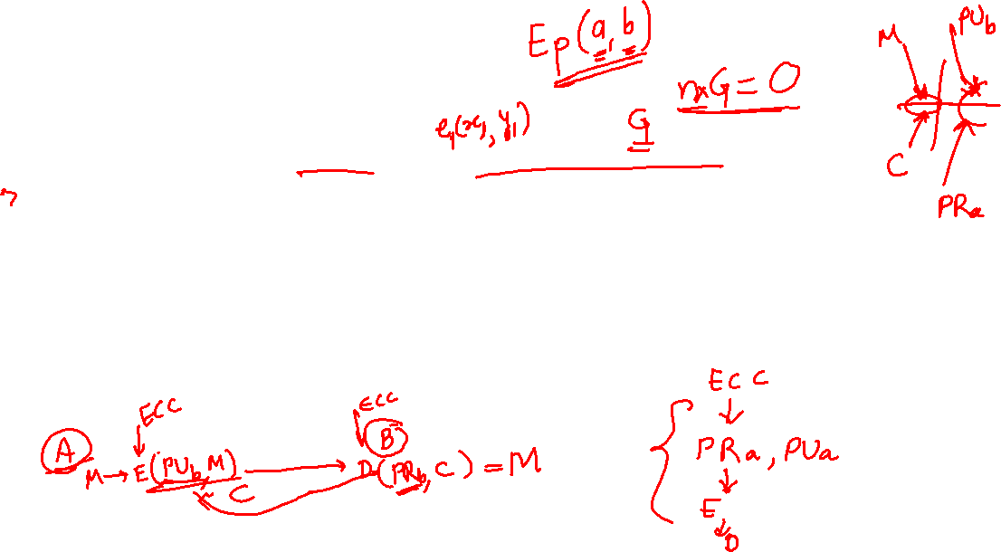
Session VII : ECDSA
Elliptic Curve Cryptography (ECC):
ECC encryption/decryption:
Participants select the curve and the generator point on the curve
These are used to compute keys, ciphertext and retrieve plaintext
Each user selects a private and public key pair
Private key is kept secret while public key is distributed
Receivers public key is used to encrypt the message
Receiver uses his/her own private key to decrypt the message
Finite curves are used in cryptography

Slide 19
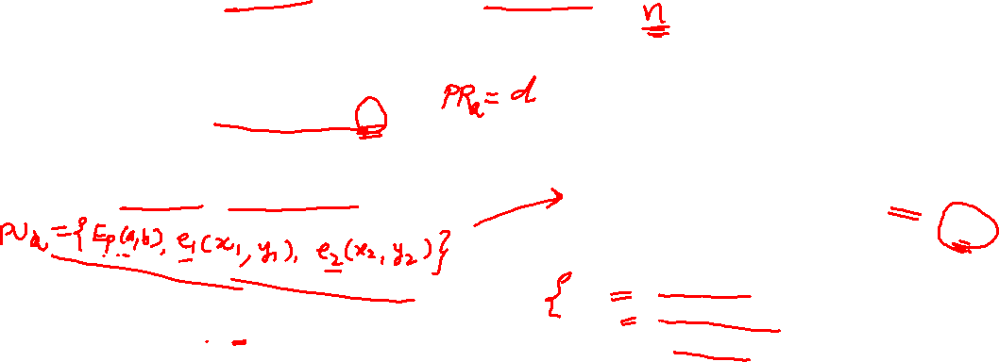
Session VII : ECDSA
Elliptic Curve Cryptography (ECC):
ECC encryption/decryption: ElGamal
Select the curve - E_{p}(a,b) and a point – e₁(x₁, y₁) on the curve (typically a generator point)
1. Compute key pair:
Bob:
Private key: Select a random integer d ∈ {2,3,...,n−1}
Public key:
Compute e₂(x₂, y₂) = d X e₁(x₁, y₁)
2. Encryption
Alice:
Alice wants to encrypt the message P as a point on the curve and a random number r
Compute C₁ and C₂ as –
C₁ = r X e₁(x₁, y₁)
C₂ = P + r X e₂(x₂, y₂)
Alice sends (C₁ , C₂) to Bob
3. Decryption
Bob:
Bob recovers P = C₂ − d X C₁ using his private key d

Slide 20
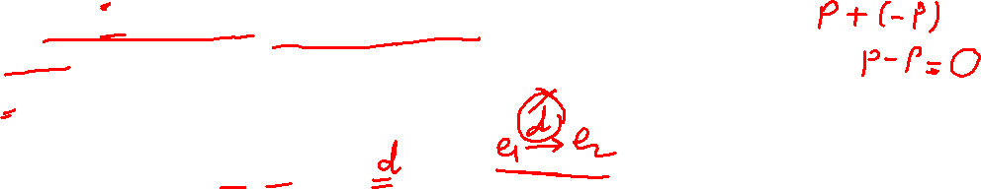
Session VII : ECDSA
Elliptic Curve Cryptography (ECC):
ECC encryption/decryption:
Correctness:
P = C₂ − d X C₁
= (P + r X e₂(x₂, y₂)) – ( d X r X e₁(x₁, y₁) )
= P + (r X d X e₁(x₁, y₁) ) – ( d X r X e₁(x₁, y₁) )
= P + O
= P
Security
An eavesdropper knows e1, e2
Computing the d is equivalent to solving an instance of the DHP in G(points on the ECC)

Slide 21

Session VII : ECDSA
Elliptic Curve Cryptography (ECC):
ECC encryption/decryption: ElGamal
Example: E₁₃(1,1) and e₁(x₁, y₁) = (0,1)
Bob:
Compute key pair:
Private key: A random integer 2 ∈ {2,3,...,n −1}.
Public key:
Compute e₂(x₂, y₂) = 2 X (0,1)
Encryption
Alice:
Alice wants to encrypt the message P(8,1) as a point on the curve and a random number r = 2
C₁ = 2 X (0,1)
C₂ = (8,1) + 2 X e₂(x₂, y₂)
Alice sends (C₁ , C₂) to Bob
Decryption
Bob:
Bob recovers P = C₂ − d X C₁ using his private key d

Slide 22
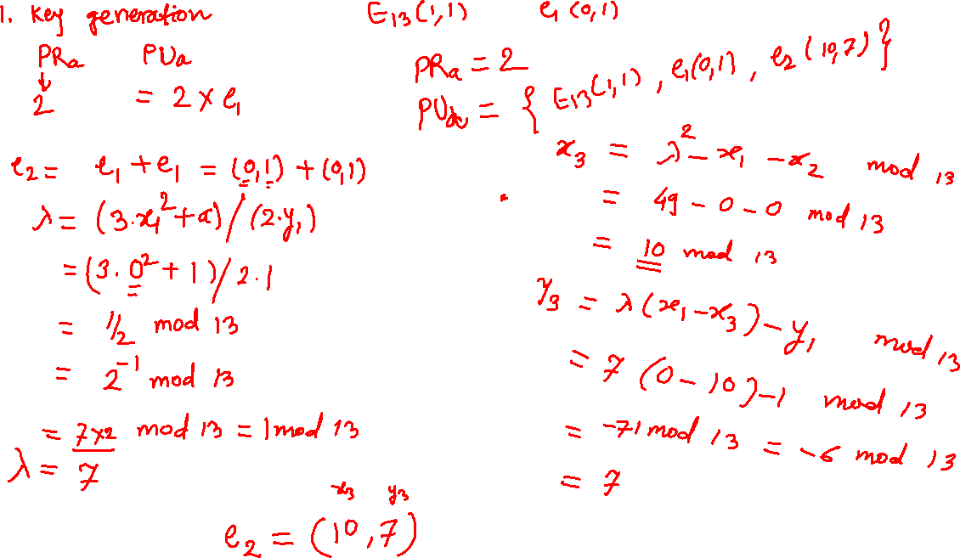

Slide 23
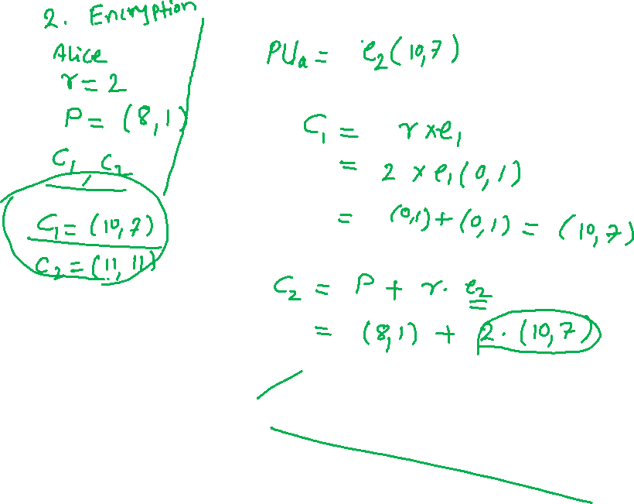

Slide 24
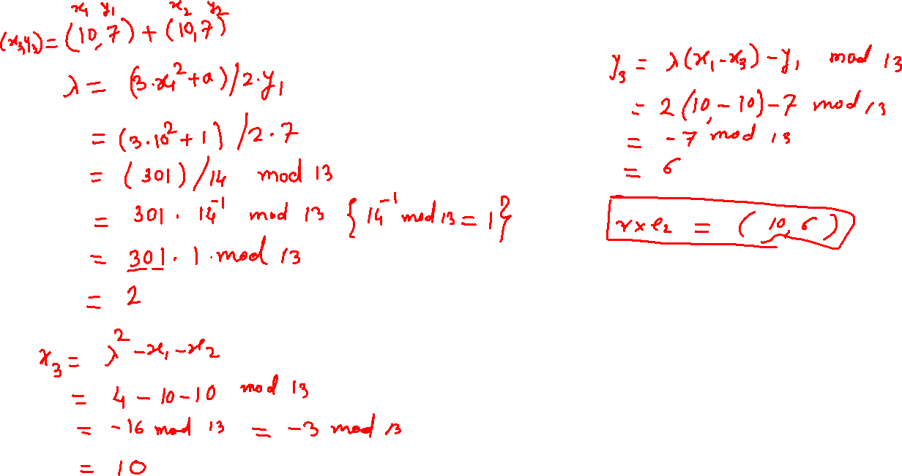

Slide 25
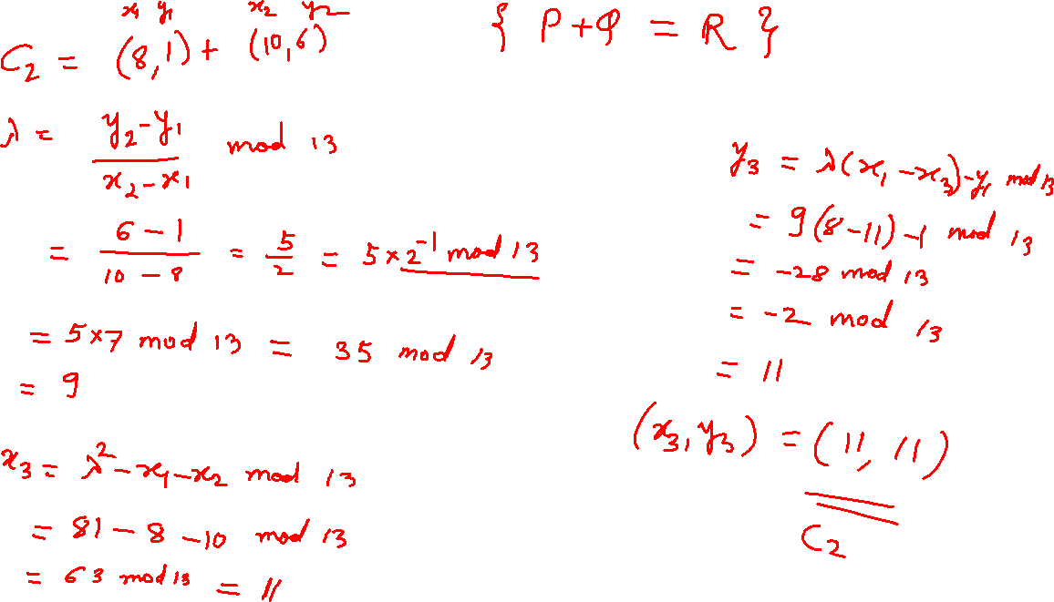

Slide 26
